Slide 1
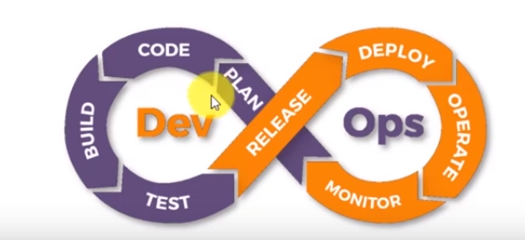
DevOps Introduction

Slide 2
Course Objective
After Completing this course you should be able to:
Understand Software Development Life Cycle models/methodologies.
Identify need of DevOps methodology and its life cycle stages.
Explore tools used in different stages of DevOps life cycle.
Implement Continuous Integration build pipeline for web applications.
Design a Continuous Delivery/Continuous Deployment using Containers orchestration Services.
Setup and manage staging/production servers using configuration management services.
Create a Continuous Monitoring services to monitor infrastructure.

Slide 3
DevOps Course Outline
Software development Life cycle methodologies
Why DevOps ?
DevOps Stages
Ubuntu basics and Networking Concepts
Software Version Control Management
Continuous Integration Tools – Jenkins
Continuous Testing – Selenium Testing
Continuous Delivery
Continuous Deployment – Containers , Container Orchestration Services
Configuration Management
Continuous Monitoring

Slide 4
Skills of DevOps Engineer
Ubuntu – File System, CLI, Shell Scripting, Services and Utilities.
Windows Operating System – Batch Commands, Power Shell scripts, Services, Advanced Security settings.
Web Application - Static Websites, Dynamic Websites.
Web Servers – Apache2, Tomcat, IIS and Nginx etc..
Databases – mysql query and basic operations.
Continuous Integration Services - Jenkins
Docker Containers – DockerFile, Docker Compose and Docker Images.
Container Orchestration Services – Kubernetes, Docker Swarm.
Continuous Testing – Selenium, NUnit, MSTest.
Configuration Management – Ansible
Continuous Monitoring - Nagios

Slide 5


Skills of DevOps Engineer
Operating Systems - File System, CLI, Batch Commands, Scripts, Utilities, Configurations, Services and Application Deployment.

Slide 6
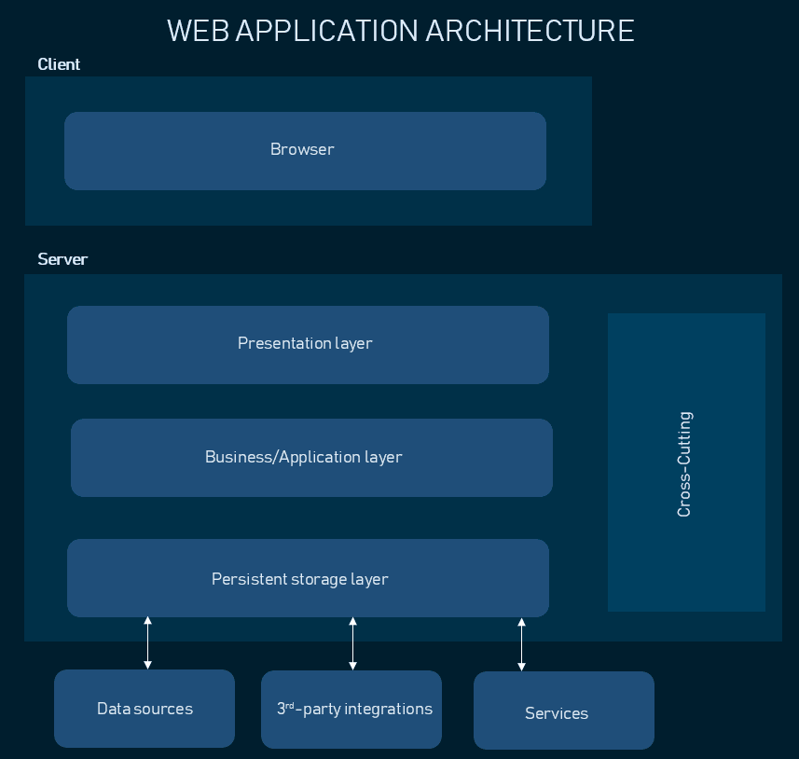
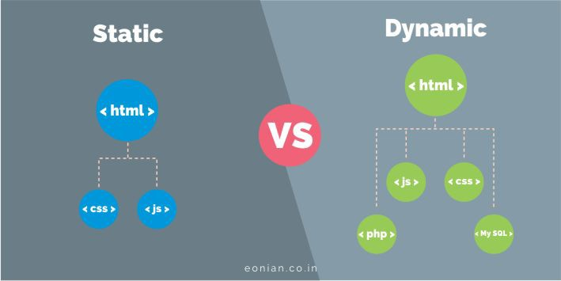
Skills of DevOps Engineer
Web Application layers and Components

Slide 7
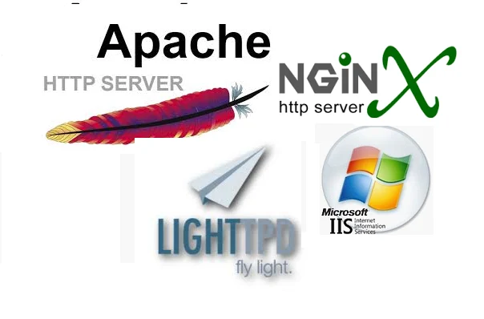
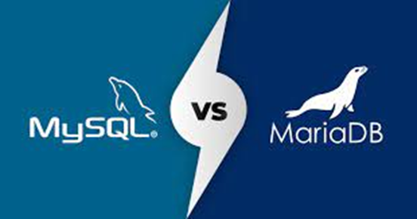
Skills of DevOps Engineer
Web Servers
Databases

Slide 8
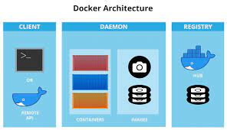
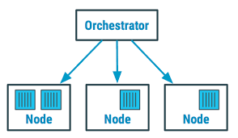
Skills of DevOps Engineer
Docker Container Orchestration Services

Slide 9
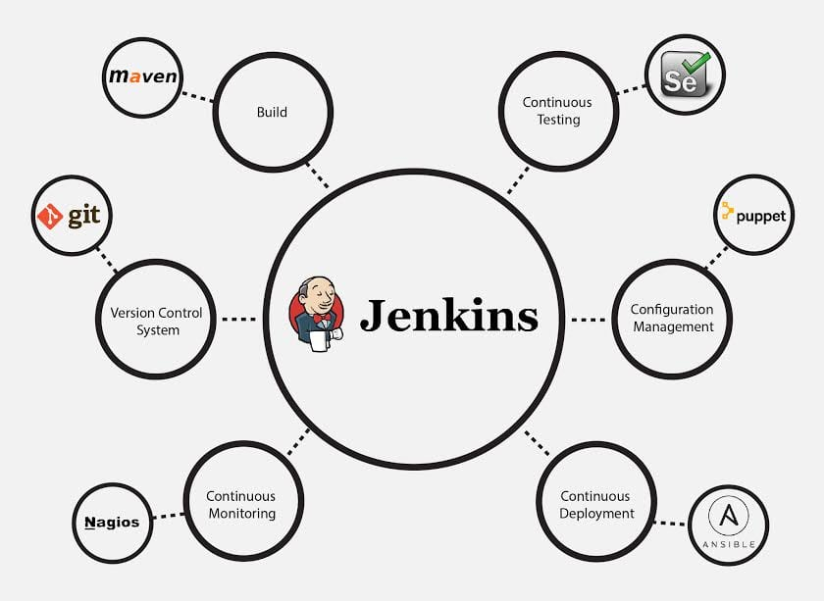
Skills of DevOps Engineer
DevOps Tools and Skills

Slide 10
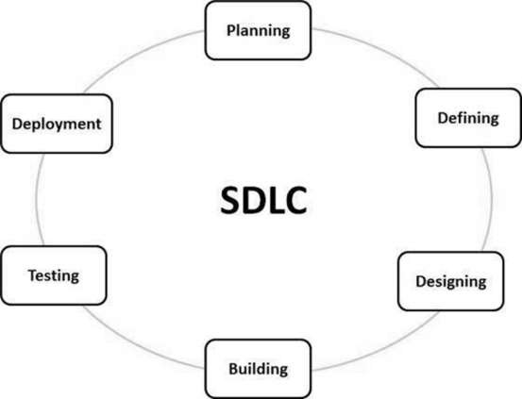
Software Development Life Cycle

Slide 11
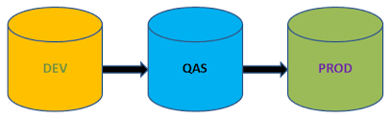
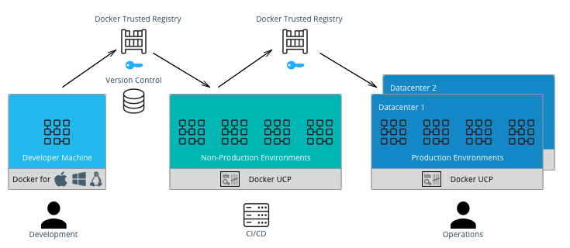
Software Product Life Cycle

Slide 12
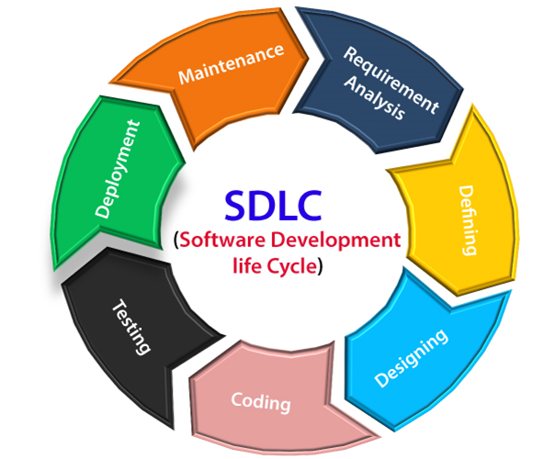
Software Development Life Cycle

Slide 13
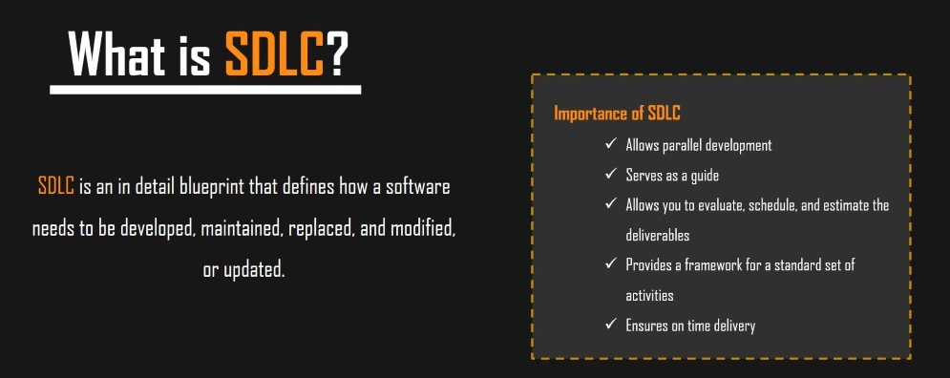
Software Development Life Cycle(SDLC)

Slide 14
Software Development Life Cycle(SDLC)

Slide 15
Software Development Life Cycle(SDLC)

Slide 16
Software Development Life Cycle(SDLC)

Slide 17
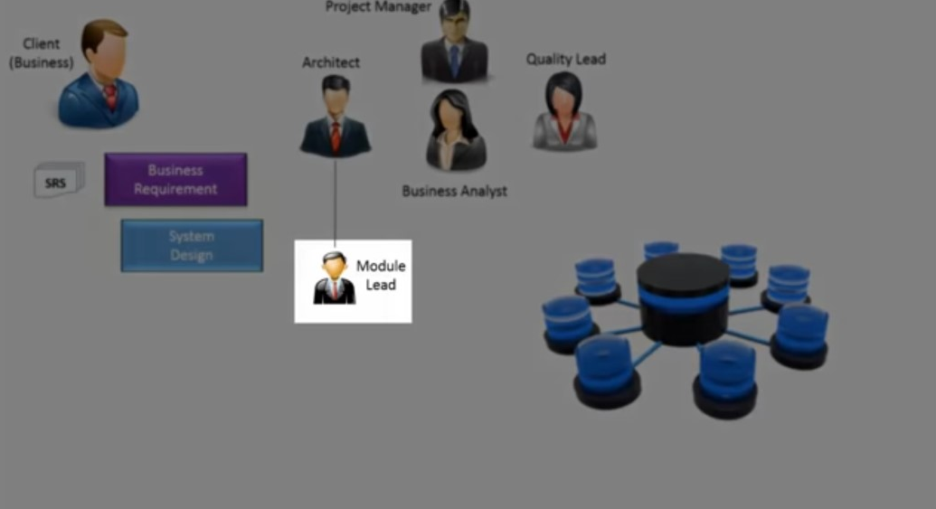
Software Development Life Cycle(SDLC)

Slide 18
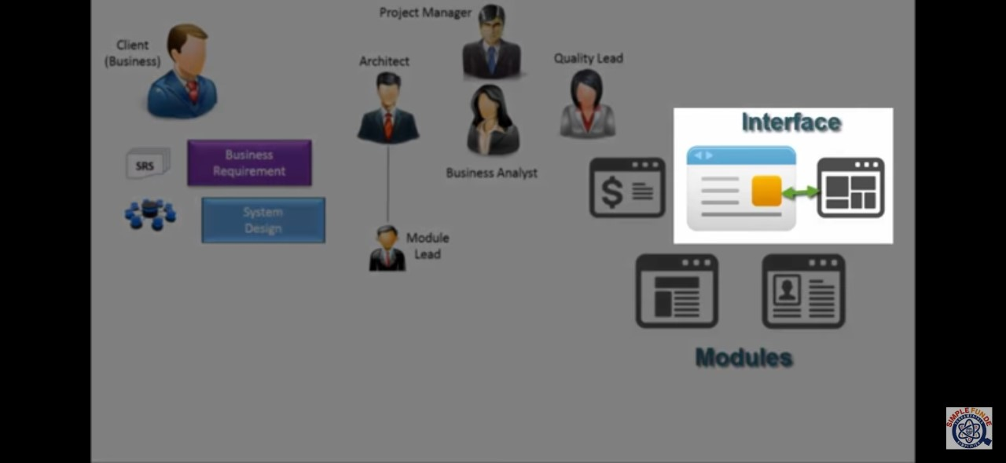
Software Development Life Cycle(SDLC)

Slide 19
Software Development Life Cycle(SDLC)

Slide 20
Software Development Life Cycle(SDLC)

Slide 21
Software Development Life Cycle(SDLC)

Slide 22
Software Development Life Cycle(SDLC)

Slide 23
Software Development Life Cycle(SDLC)

Slide 24
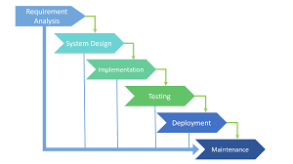
Traditional Software Development Methodologies

Slide 25
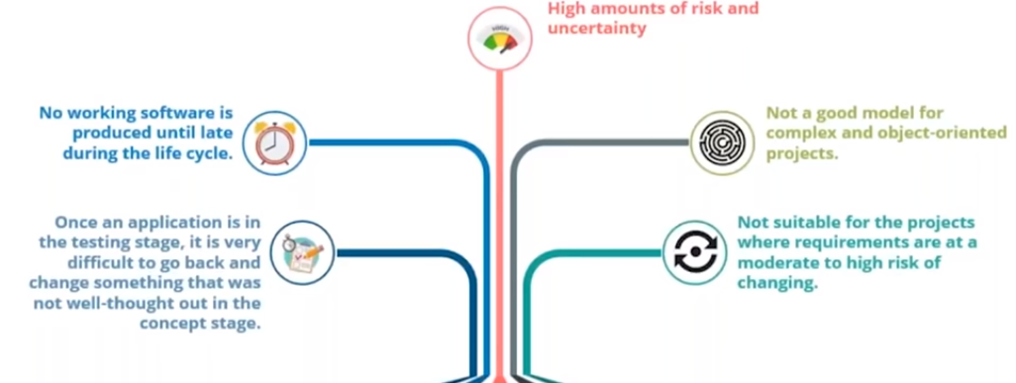
Drawbacks /Limitations of Waterfall Model

Slide 26
Agile Software Methodology

Slide 27
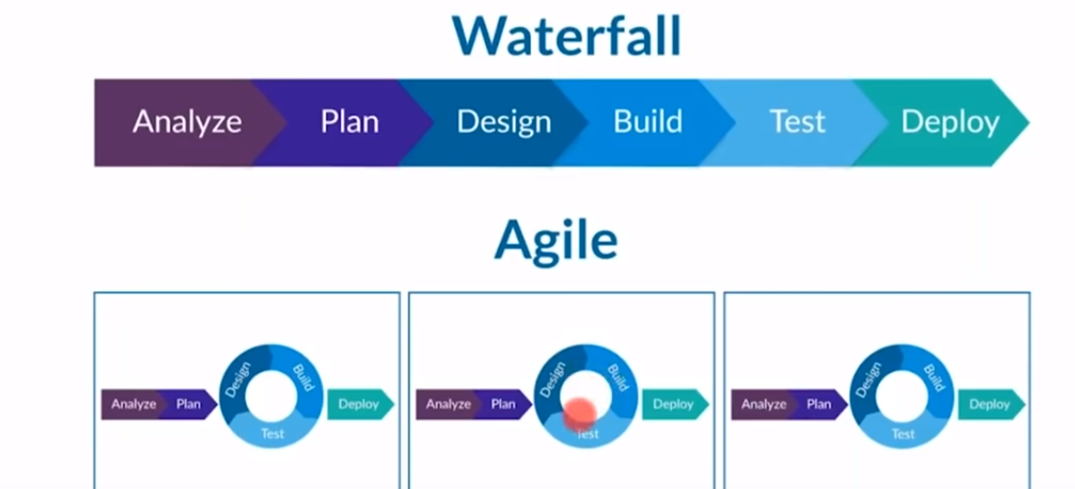
Comparison of Agile vs Waterfall Models

Slide 28
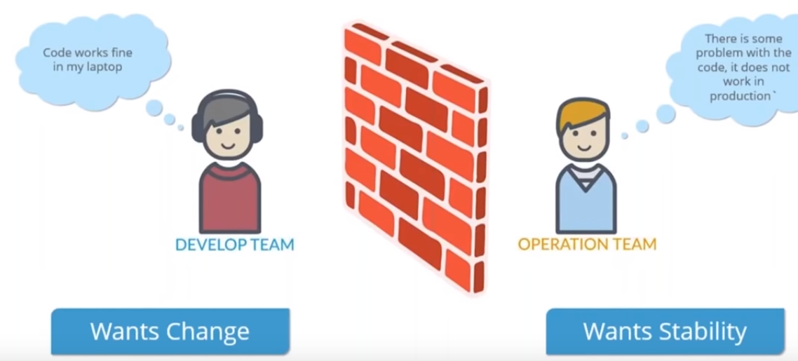
Limitations of Agile Methodology

Slide 29
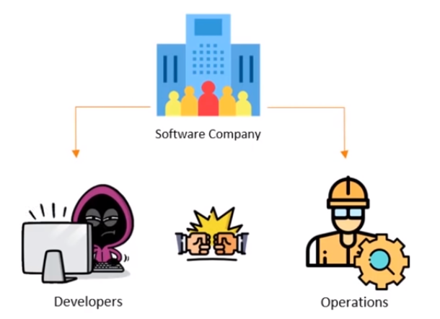
Software Product Life Cycle

Slide 30
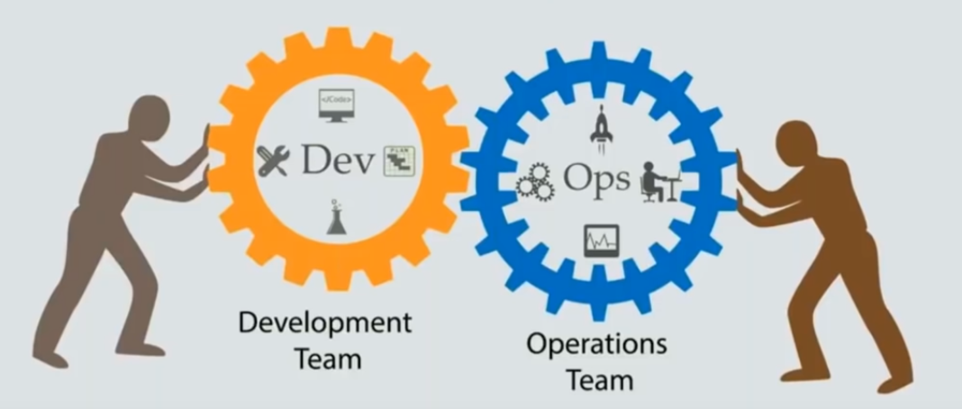
Solution is ?

Slide 32
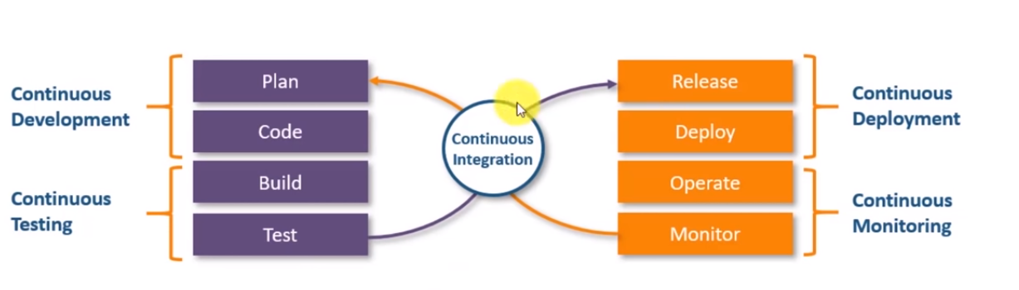
DevOps Introduction

Slide 33
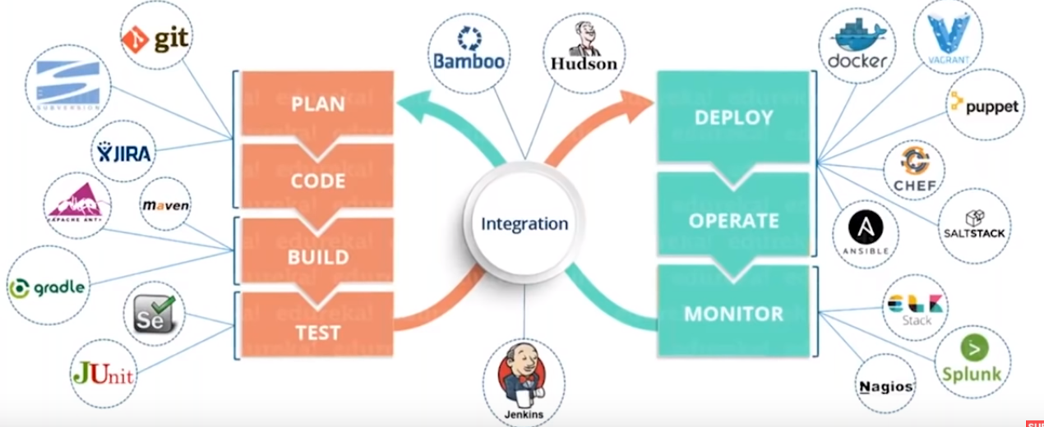
Devops

Slide 34
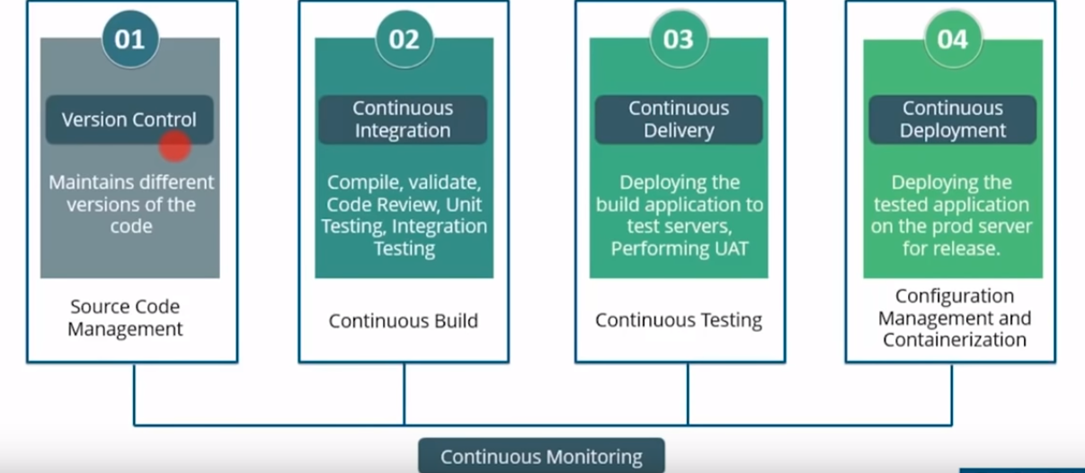
Devops Stages

Slide 35
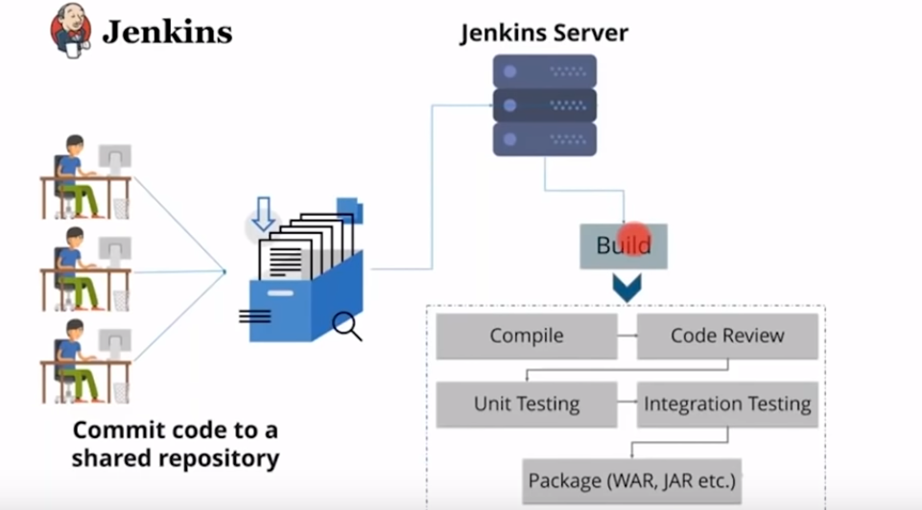
Continuous Integration

Slide 36
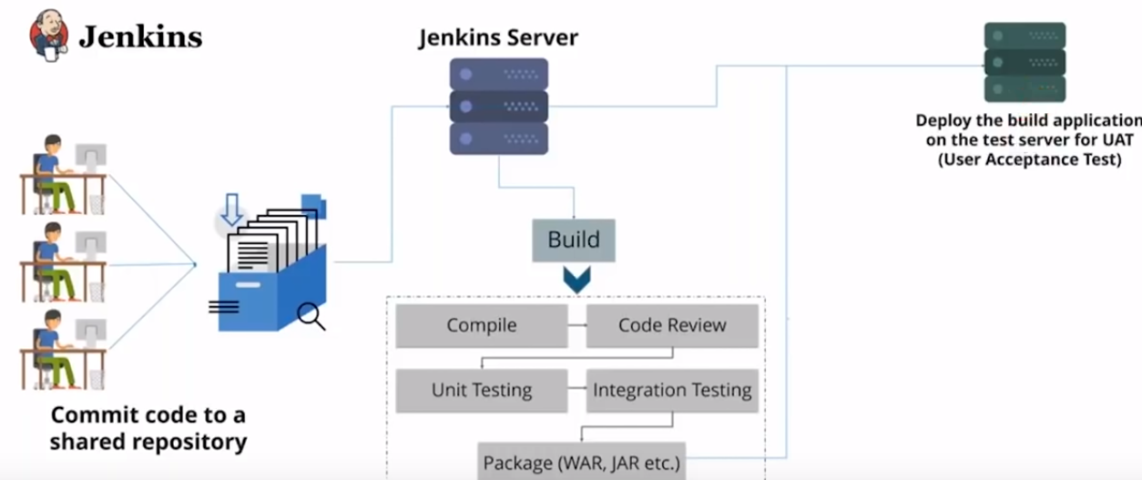
Continuous Delivery

Slide 37
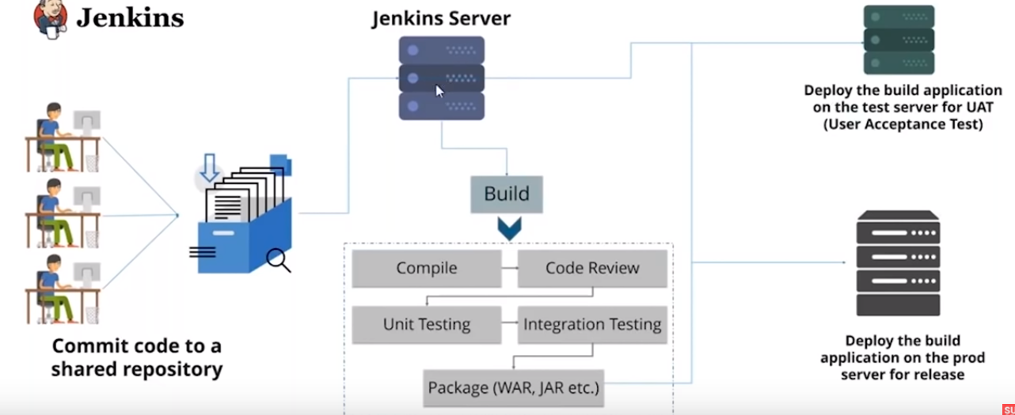
Continuous Deployment

Slide 38
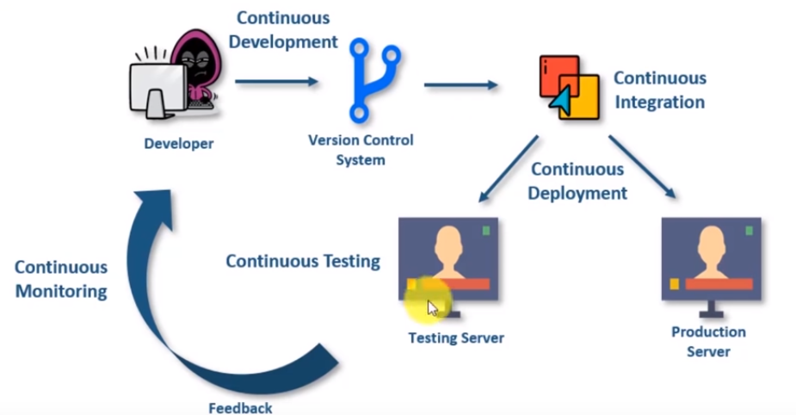
How Devops Works

Slide 39
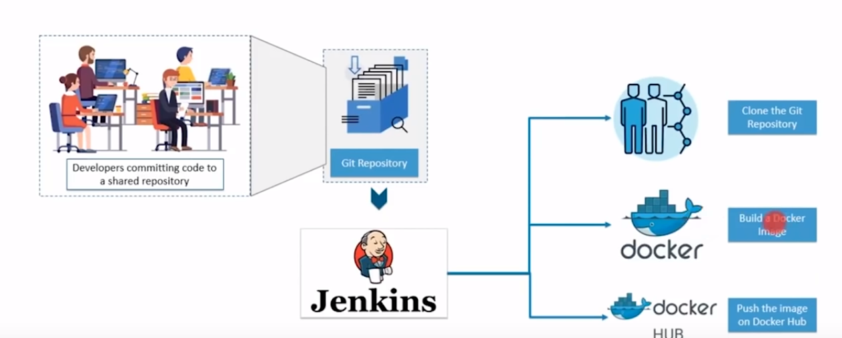
Devops Use case

